Slide 1
AWS SysOps
Security

Slide 2
Compliance Frameworks
ISO
PCI
HIPAA

Slide 3
DDoS
Distributed Denial of Service
Amplification/Reflection attack: NTP, SSDP. Sending request as a spoofed IP
Layer 7 attacks – flood of GET requests, Slowloris – holds connections
How to mitigate?
Use ALB using WAF – minimize attack surface area
Enable auto scaling to absorb attack
Create plan for attacks

Slide 4

AWS Shield
Free service that protects all customers on ELB, CDN, Route53
Protects against layer 3 and 4 attacks (reflection)
Advanced Shield:
Costs $3000
Flowbased monitoring of network traffic
DDoS response team 24/7

Slide 5
Marketplace
Barracuda
Kali linux for penetration testing – you will still need permission from AWS for this, fill form for it

Slide 6
IAM
Can create custom policy for e.g. give admin access to S3 bucket
Create a role and associate policy with role
Attach role to EC2 – this can be attached to a running EC2.
It takes effect immediately but not really ☺

Slide 7

MFA
Can be enabled from console using google authenticator
Can be enabled from console as well
aws iam create-virtual-mfa-device --virtual-mfa-device-name EC2-User --outfile /home/ec2-user/QRCode.png --bootstrap-method QRCodePNG
aws iam enable-mfa-device --user-name EC2-User --serial-number arn:aws:iam::"USERNUMBERHERE":mfa/EC2-User --authentication-code-1 "CODE1HERE" --authentication-code-2 "CODE2HERE"

Slide 8
STS
Grants users temporary and limited access to AWS resources
Federation (AD)
Cross account
Federation (With mobile apps)

Slide 9

Logging
Cloudtrail - monitors API calls in AWS platform
AWS Config – state of AWS environment
CW logs – monitors performance
VPC Flow logs – IP address of network traffic
Log file alerts:
Cloudtrail notifications – using SNS topics
AWS Config - Log changes to system components
Control of logs
IAM and S3 controls

Slide 10
AWS Hypervisors
Software, firmware or hardware that creates VMs (running a guest OS) on a host machine
EC2 uses Xen Hypervisors
HVM is fully virtualized – Windows can only do HVM
Linux can be both Paravirtualized (PV) or HVM
Rings - 0 has highest privilege 3 has lowest
Host OS operates in ring 0, guest OS ring 1, Apps in ring 3

Slide 11
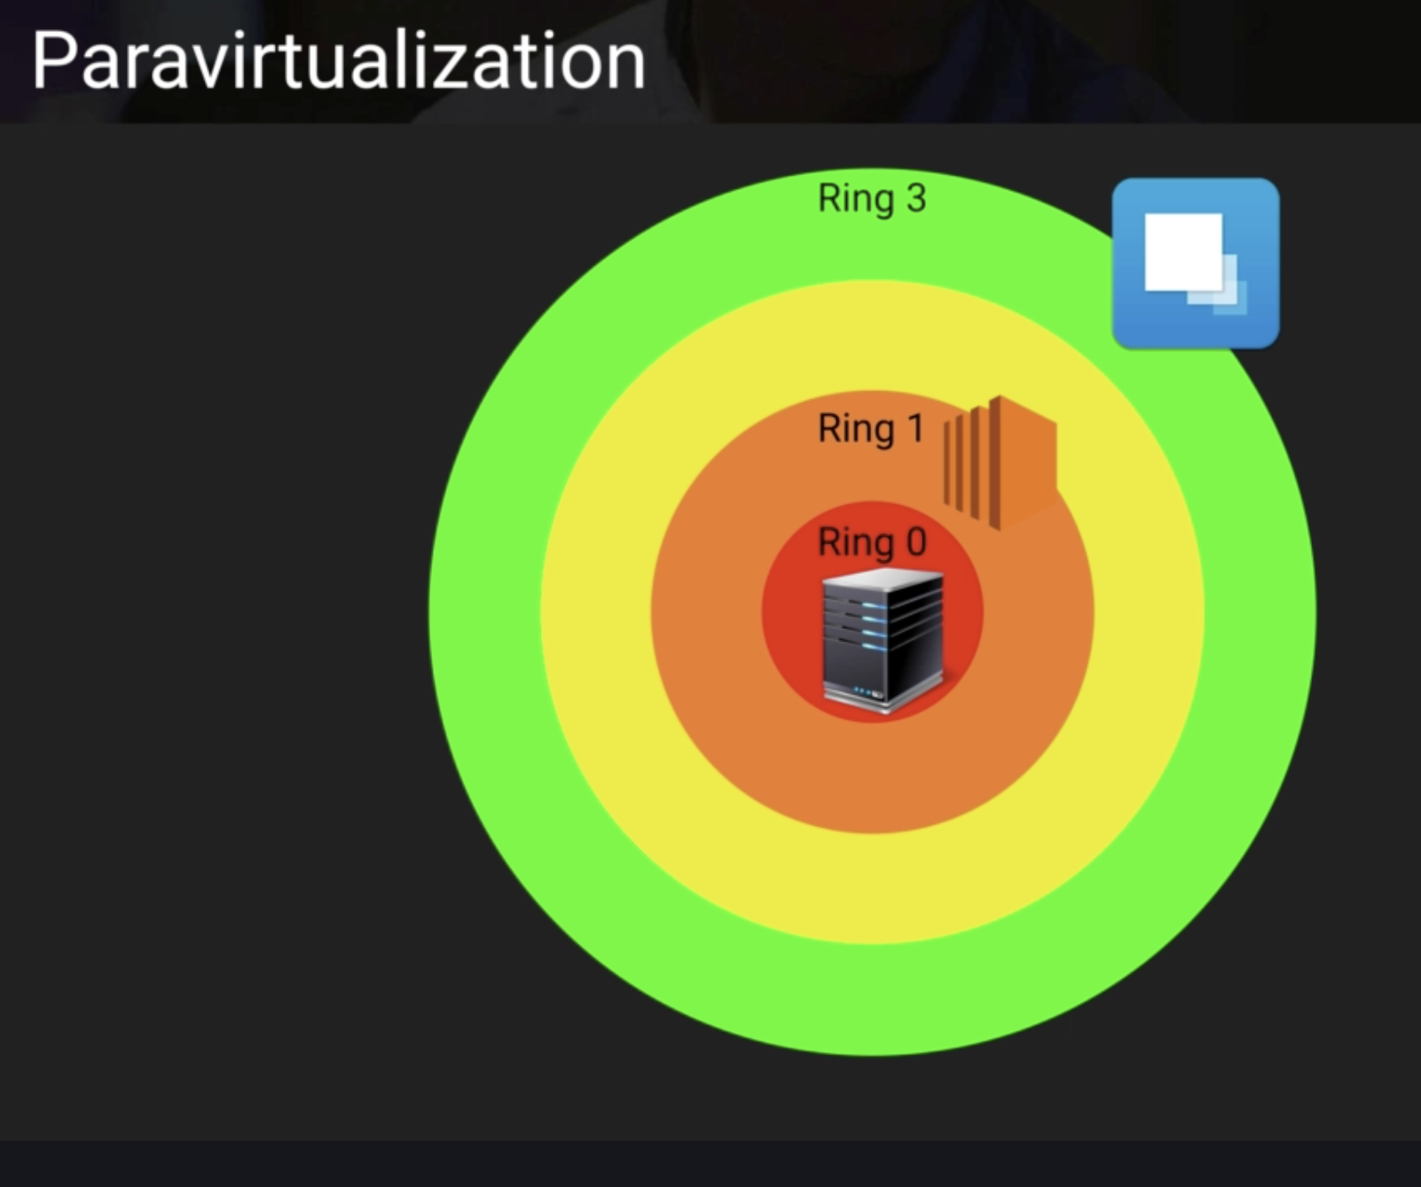
PV

Slide 12
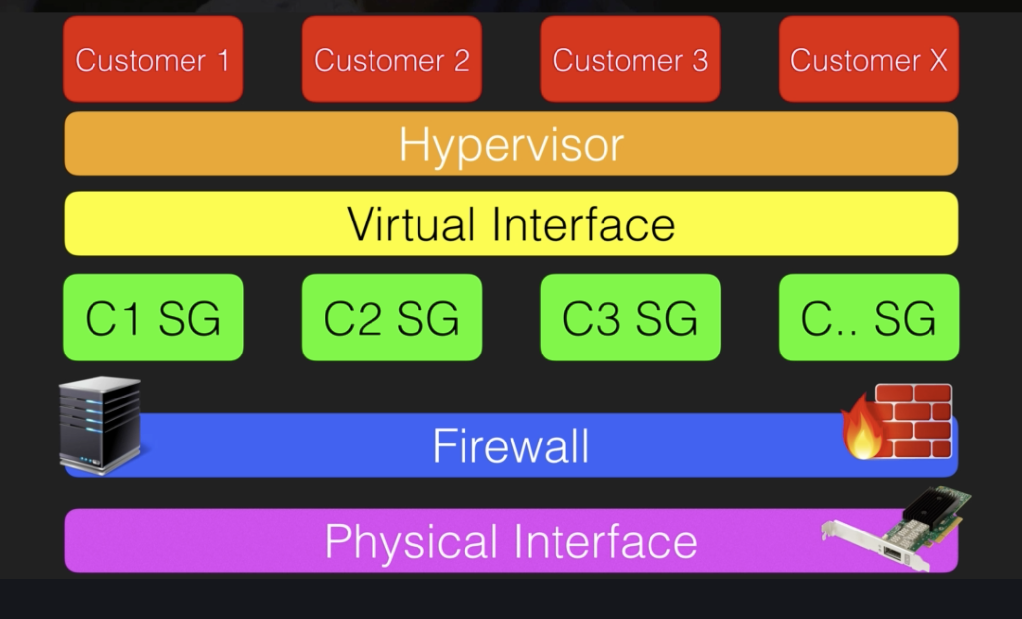
Isolation

Slide 13
More Hypervisor stuff
Access - Admins with business need
Memory scrubbing – EBS automatically resets every block of storage – no accidental data exposure during reuse

Slide 14
Dedicated instances vs hosts
Dedicated instances – same hardware host within VPC of same AWS account
Dedicated hosts – gives additional visibility and control over how instances are placed on physical server, allows targeting of instance placement

Slide 15
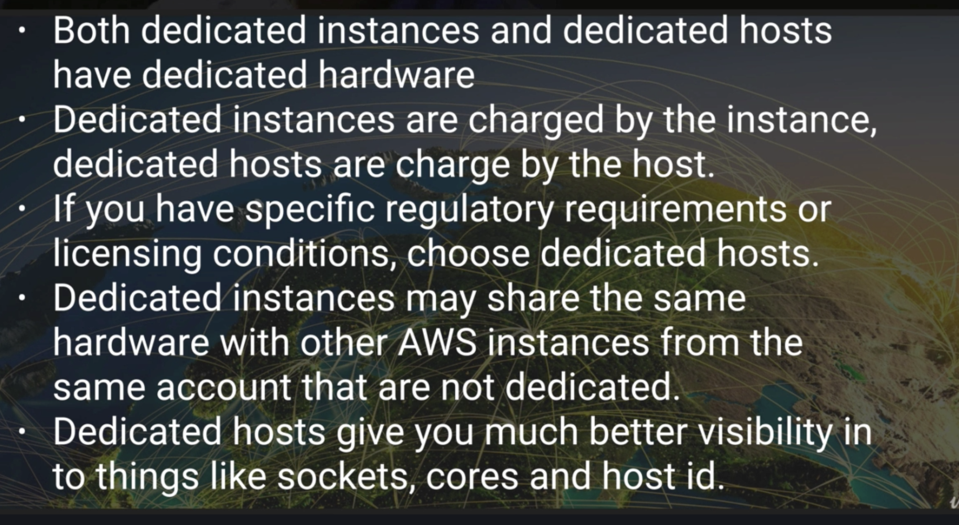

Slide 16
SSM
Run command: Automate common admin tasks on EC2s, installing, applying latest patches
Parameter store:
String
String list (comma separated strings)
Secure string (encrypt using kms)

Slide 17
AWS Config - No public read and write rule
Presigned URLs S3
Can be generated from CLI
TTL can be set, default is 60 mins 3600 seconds (--expires-in)
Do not need ACL or bucket policy
aws s3 presign s3://<bucketname>

Slide 18
AWS Inspector
Automated security assessment service
Inspects for vulnerabilities and deviations, assesses them and produces a list of findings
How?
Create assessment target
Install agents on EC2
Create assessment template
Perform assessment run
Review findings against rules
Generate detailed reports

Slide 19
Trusted Advisor
Will advice you on:
Cost optimization
Performance
Security
Fault Tolerance
Does not need agent
SG:
Use cloudtrail to find who is creating EC2s
Athena to analyze query logs sent to S3

Slide 20
